Slide 1

ACDI/VOCA toolset Social Data Society
2018/12/17

Slide 2

ACDI/VOCA in Brief
Founded in 1963
501(c)(3) non-profit organization
Total revenues for ACDI/VOCA and Affiliates of approximately $143M
~30 active projects in 28 countries
~1,800 employees
Notes:
Add a picture! ;)

Slide 3
The concept…

Slide 4

Data Management Conceptual Framework
- Steph Locke (@SteffLocke)

Slide 5


Data Management Conceptual Framework Options
VALUE
VALUE
PEOPLE
PROCESS
T
O
O
L
S
PEOPLE
PROCESS
TOOLS
MERL THEORY
IT + DATA THEORY
Paper Forms
Technocratic dummy
VALUE
VALUE
PEOPLE
PROCESS
TOOLS
PEOPLE
PROCESS
TOOLS
THEORY?
MERL THEORY + DATA THEORY
External Contractor
System

Slide 6


LEAP Conceptual Framework in Practice
10-day training
Remote support
MERL Policy
Constant Follow-up
Standard custom raw relational database
Standard webpage
Automated reports
Standard data input
& processing
VALUE
PEOPLE
PROCESS
TOOLS
THEORY
STOP!
… or I’ll yell “STOP!” again!!!!

Slide 7



FULL RAW
DATA
APPROACH
AGGREGATE
DATA
APPROACH
checks
PROJECT STAFF
A TON!
SLOW
CUSTOM
RESPONSIBLE
AMOUNT OF DATA
QUERY SPEEDS
REPORT TYPE
HQ STAFF
VERY LITTLE VERY FAST!
STANDARD
TECHNOLOGY

Slide 8




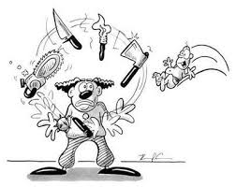
Under the Hood…
Techie
warning!!

Slide 9
















LEAP Software Stack
R-Servers
ACDI/VOCA
Each Project
Offline sync
ODBC Driver 11/13 for SQL Server
And sometimes…

Slide 10
LEAP “Backbone”
Sharepoint sites
Standard viz
Project databases
Data warehouse
Stored SQL procedures
Actuals
Shiny apps and
assorted lovelies
Gives context / metadata
M&E
Followup
Execs
HQField
Data Status
Working version
Runlogs
Command
Center
How did it go?
Specific Query error
General project error
General runner error
Other run/server health data

Slide 11
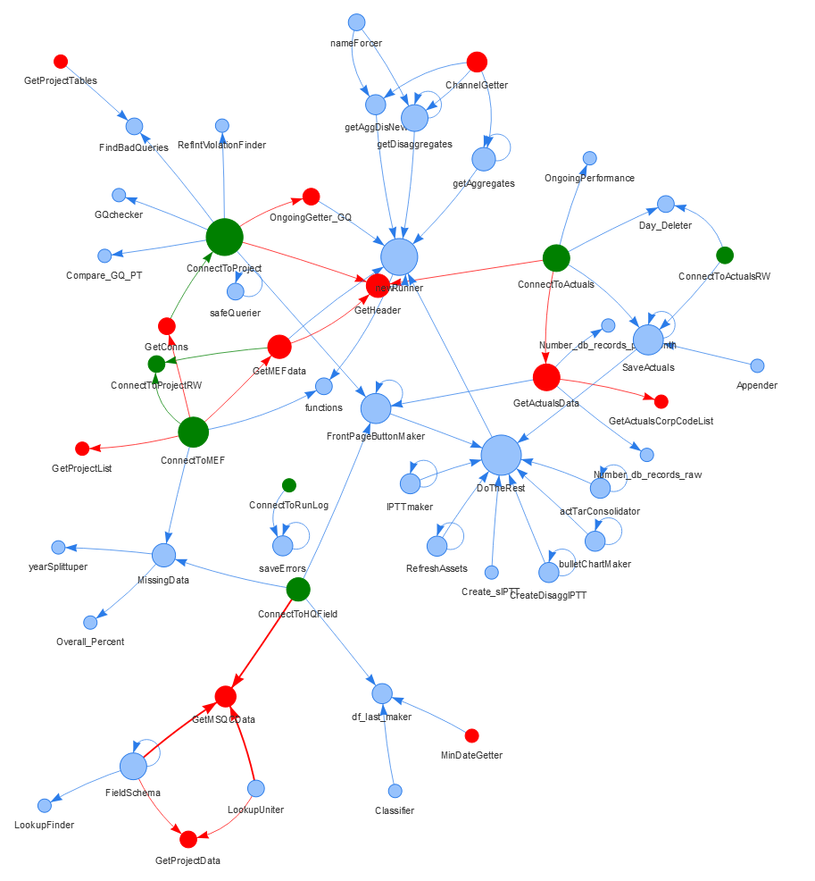
Main ACDI/VOCA package map
ConnectTo…
Get…Data
Specific Helpers
Why?
Consistency!
Unit-Testing!
Collaboration!

Slide 12
On Automated reports…

Slide 13
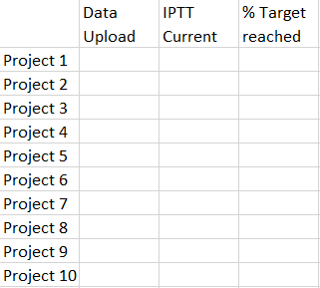
LEAP Automated Assets – Report conceptualization
Data Upload
Data Quality
% Target Reached
Data Upload
Data Quality
% Target Reached
Data Upload
Data Quality
% Target Reached
PROJECT SPECIFIC
TOPIC SPECIFIC
EXECUTIVE OVERVIEW

Slide 14
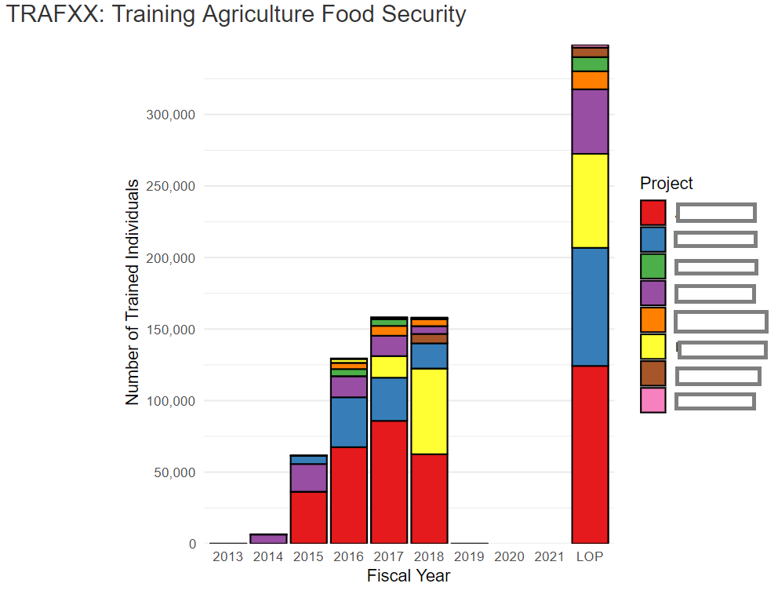
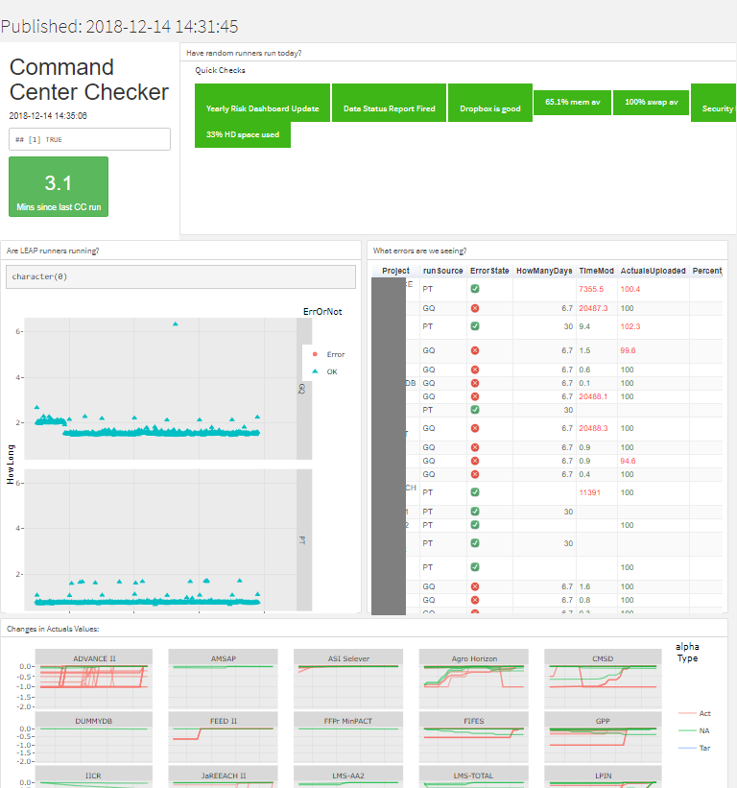
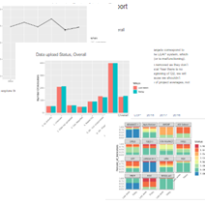
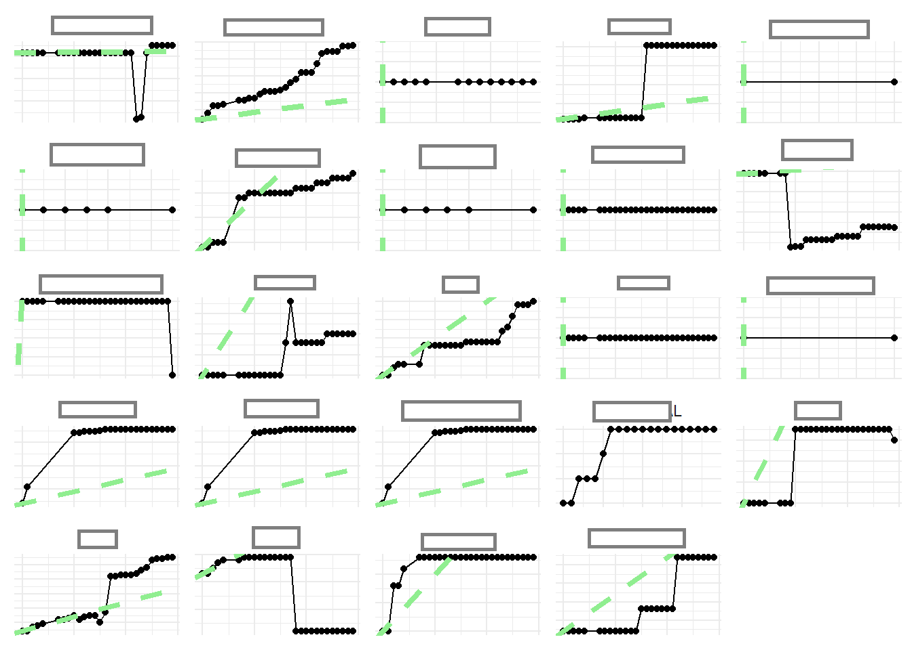
LEAP Automated Assets—Top level
Cross-project aggregation
Command Center
Data Status Report
Natural Language Generation
Excecutive Report
X is hitting its targets (routine actuals are 110% of where we should be on this year's targets), and we can trust this result since 68% of the indicator calculations have been approved by the field MERL team. Data entry looks high. This project is looking great!
Y is not hitting its targets (routine actuals are 70% of where we should be on this year's targets), but we can't trust this result since only 33% of the indicator calculations have been approved. Data entry looks very low. This project is underperforming on every metric we have, a serious look is required here.

Slide 15
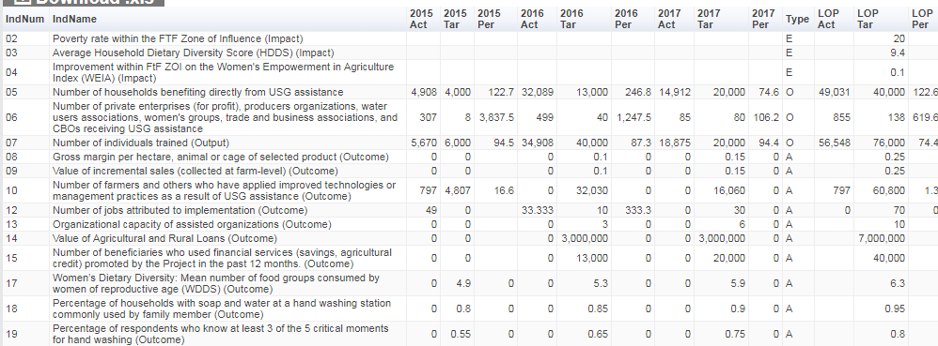
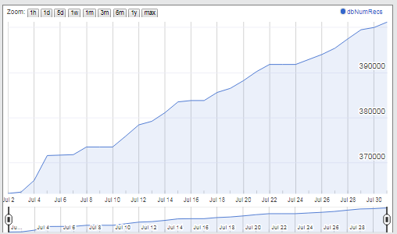
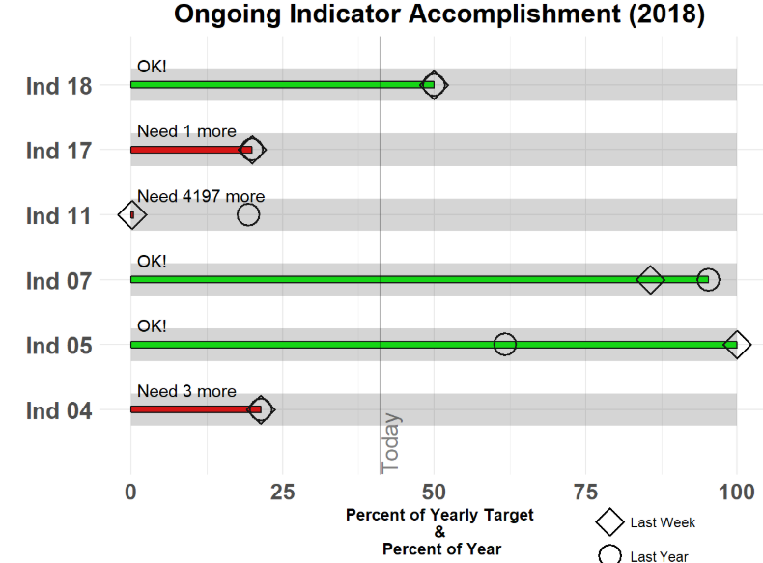
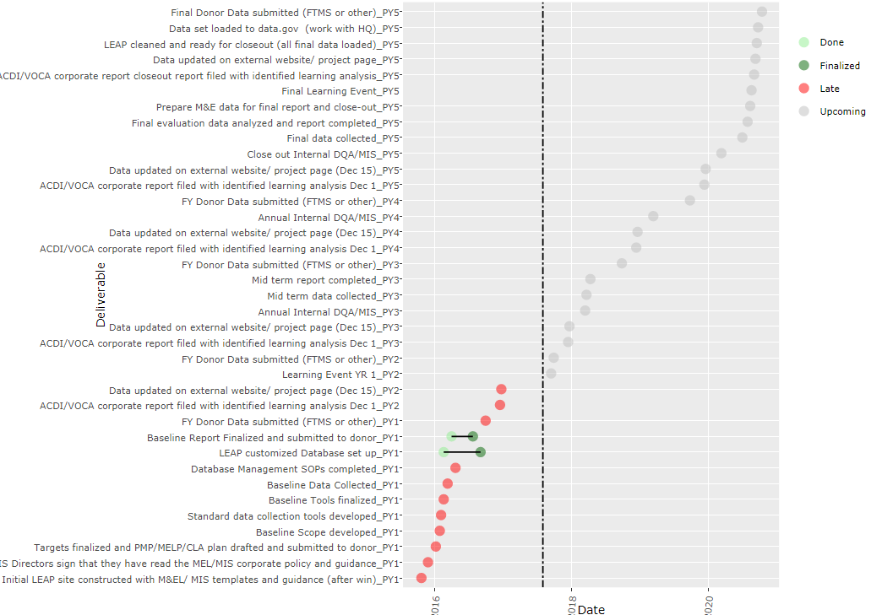
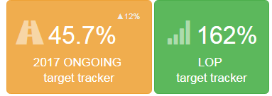
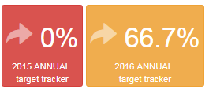
LEAP Automated Assets—Project
Auto-IPTT,
Quarterly Reports
Data
Uploads
Milestone & Action Point Tracker
Indicator
Summaries
Indicator
Performance
http://www.acdivoca.org/2018/03/introducing-the-monitoring-and-evaluation-bullet-chart/

Slide 16

We envision a world in which people are
empowered to succeed in the global economy.
www.acdivoca.org
acdivoca.org/data-digest
Amit Kohli
@vizmonkey

